Slide 1


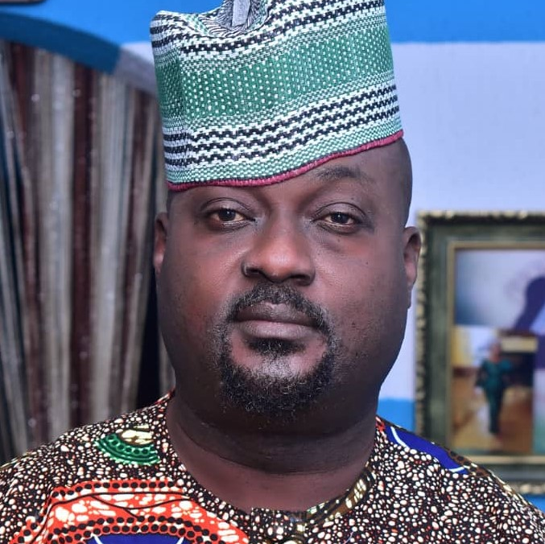
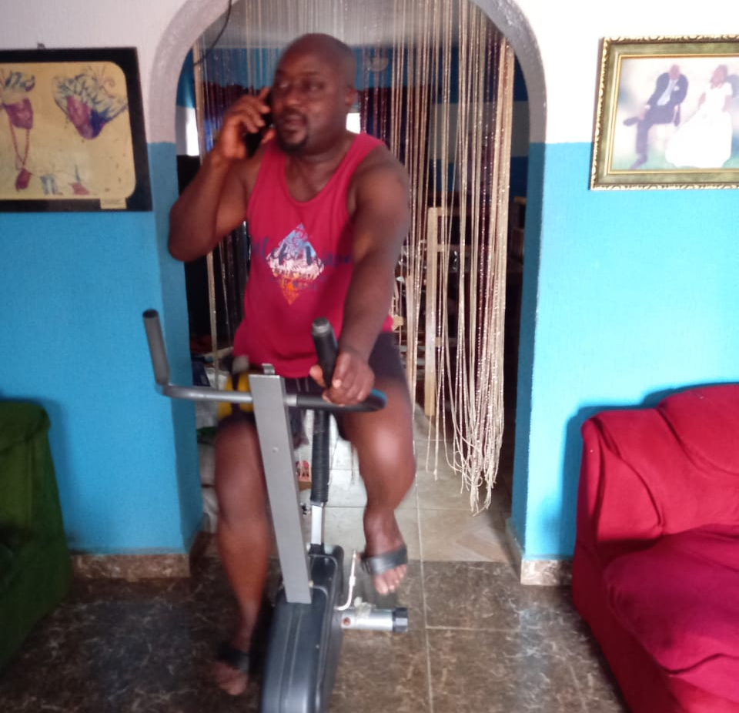
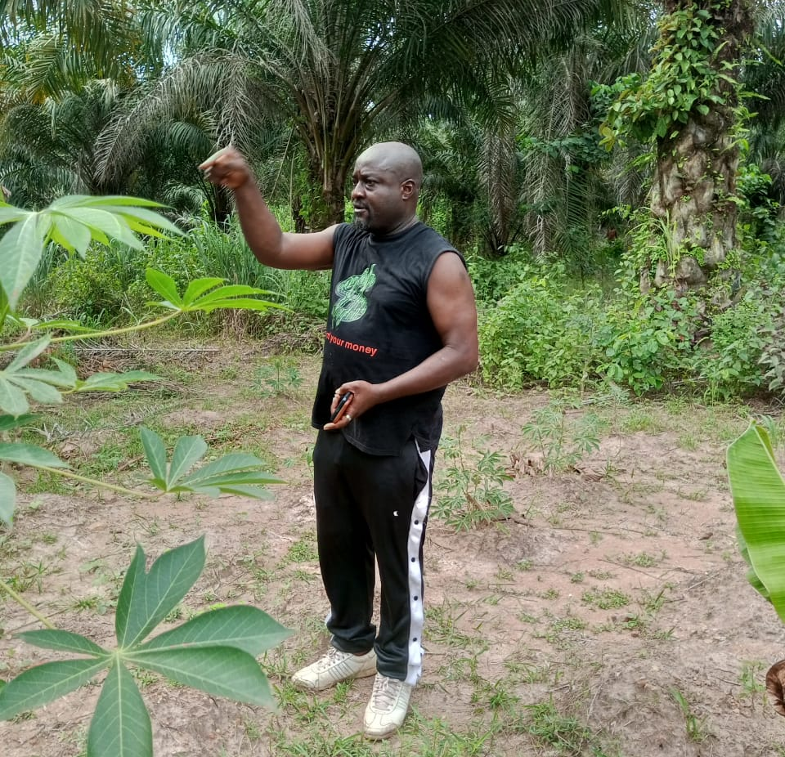
Getting to Know Me
Work
Personal
m
My role
Procurement
Significant others / family members / furry friends in my life
My wife(Olajumoke Otunla
Tenure in ofi/Olam
19 years
I engage my self on exercising and playing football
Previous companies I have worked at
Z.O OSANSANYA AUDIT FIRM
My favorite / comfort food
Yam and Egg
Why I joined ofi/Olam and what keeps me here?
1, I joined OFI because of an opportunities for growth and career development
2,what keeps me in OFI is job security, appreciation shown by top management to staffs, compensation and benefits
My favorite song
Any Lagbaja songs
Ayotunde Otunla
Ayotunde
1,I like listening to music while driving.
2,playing games with my children at home after work
Text
This is me outside work, doing stuff I enjoy in my life …

